Slide 1
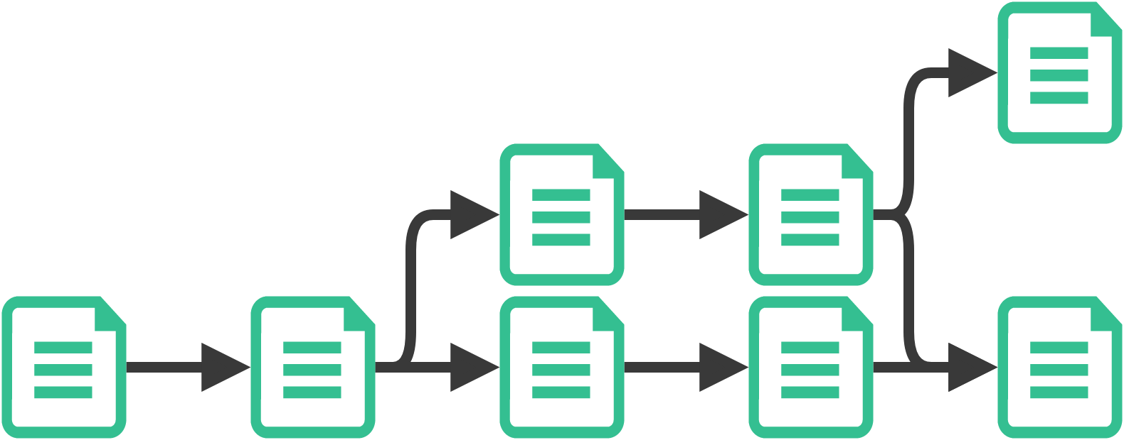

Tracking provenance of change in data science pipelines
Presenters Mark Timmerman
Edser Apperloo

Slide 2
Problem statement
How to reproduce experiments
Explain results by tracking provenance
Notes:
Quality of research can be quantified by the ability to reproduce its results
Sadly, academic research has problems with this. It is hard, and we attempt to solve some of them with this research
In order to understand why your results are different from mine we need to know the provenance of our versions
This can be achieved by tracking the provenance of changes
Solving this for everyone everywhere is a bit too much
2 minute mark

Slide 3
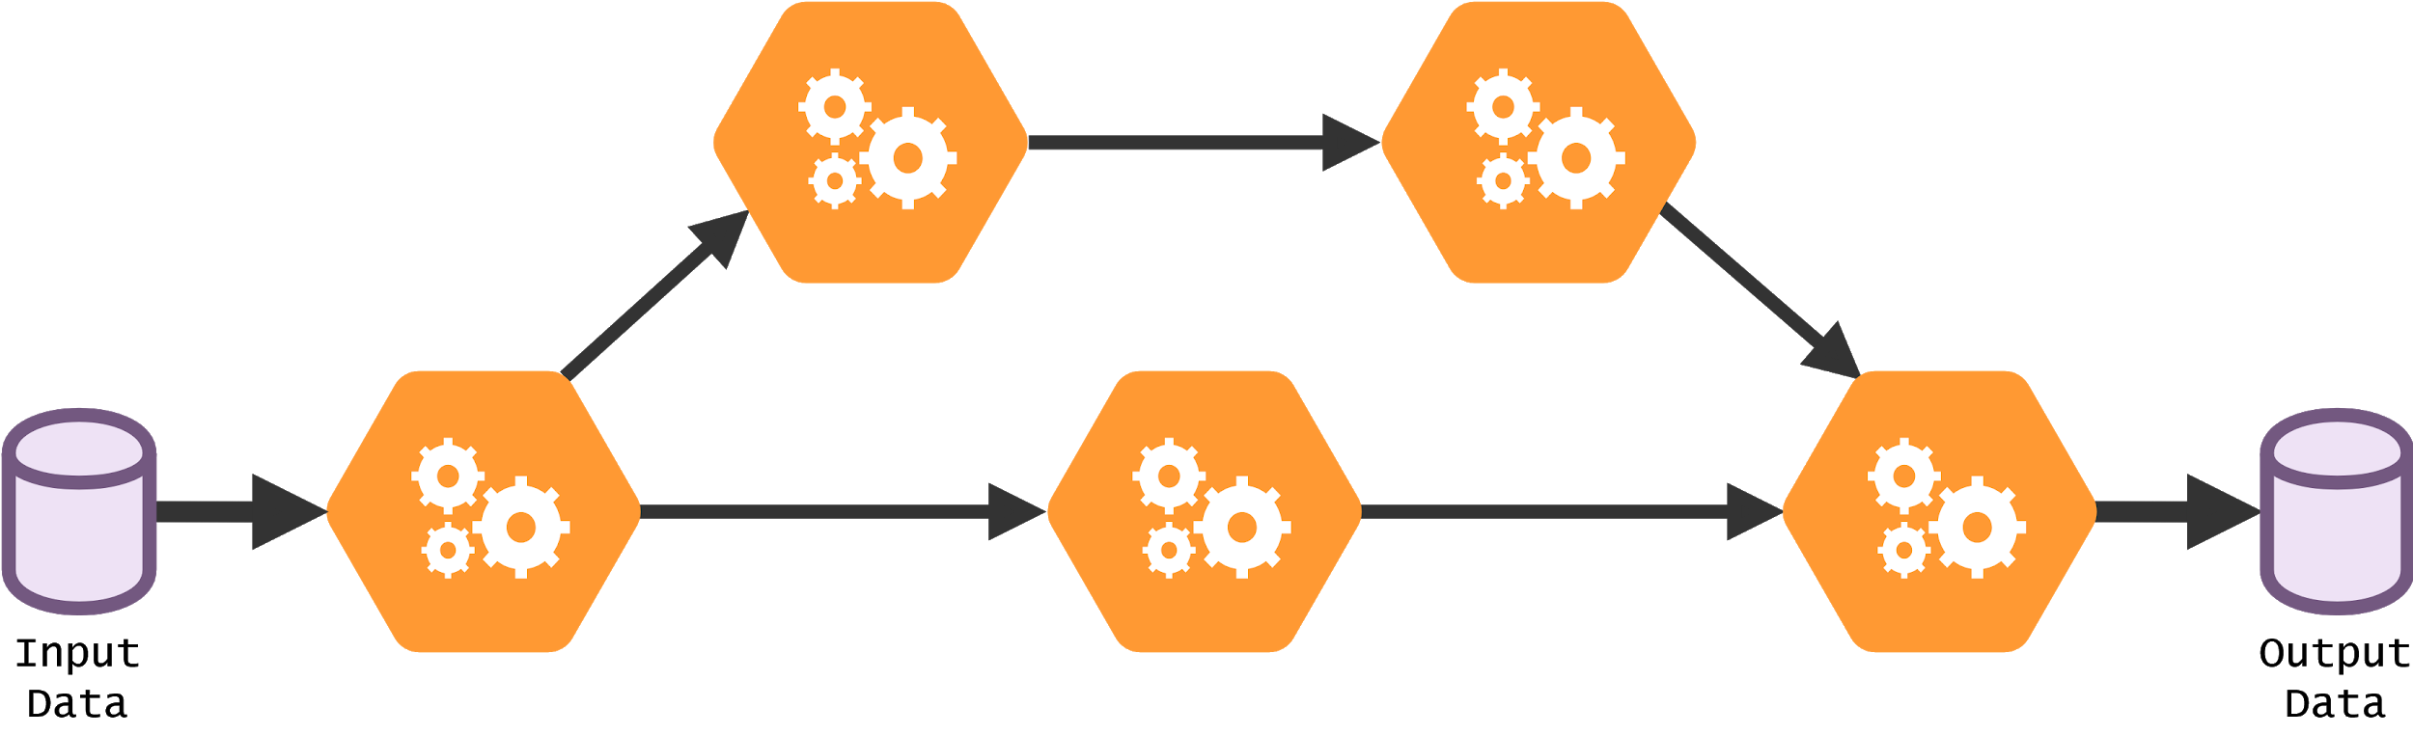
Data processing pipeline
BACKGROUND
Notes:
Traditionally a chain of steps, now a directed acyclic graph (DAG)
Multiple steps, inputs and outputs linked together: preprocess, transform, evaluate

Slide 4
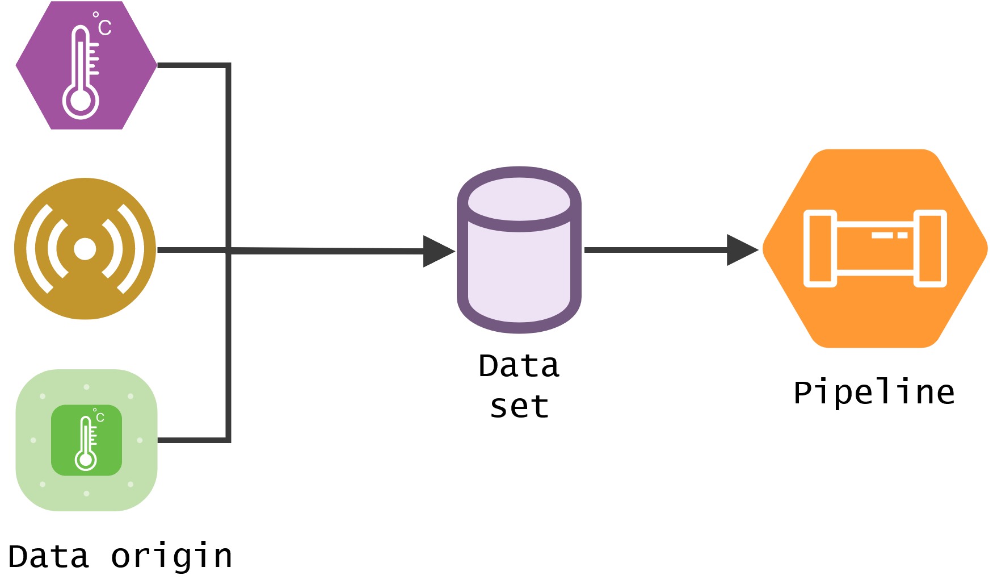
Provenance of data
BACKGROUND

Slide 5
Elements of reproducibility
PROBLEM STATEMENT
Input data
Versions of each transformation
Runtime evolutions of the pipeline
Intermediate results
Lineage trace of results
Runtime environment
Configuration of the pipeline
Failures
Notes:
Even though we’ve scoped down
There is still a LOT to handle, just to name a few….
4 minute mark

Slide 6
Research goals
Develop a framework or tool that is capable of assisting researchers
in the provenance tracking process
Notes:
Fortunately these are quite clear and bounded: so automate because humans seem to fail Possible thanks to consistent and bounded environment

Slide 7
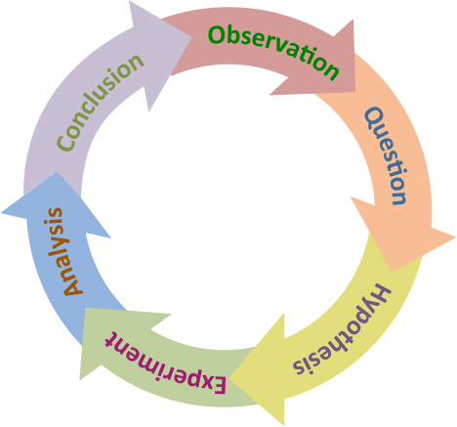
Overview
RESEARCH GOALS
Related work
Architecture
Implementation
Evaluation
Demo
Conclusions
Notes:
We’ve covered an observation
We’ve stated a problem
We hypothesize that a tool can assist humans in tackling these problems
We experimented by designing and implementing a framework that would assist in tracking provenance and keeping experiments reproducible
Analyzed this experiment by using 2 use cases from the domain
Conclusion: we’ll leave this to the end of our presentation
5 minute mark

Slide 8
Background & Related work
Data provenance
Pipeline provenance
Distributed computing
Notes:
We don’t really like it either, but we need to tell you this in order to understand why we did what we did.
3 main categories to reproducible research

Slide 9
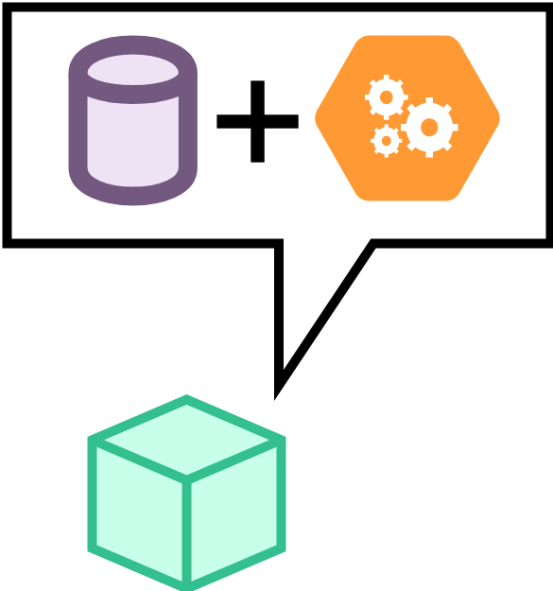


Data provenance
BACKGROUND
Code tools do not work
Binary data (photos, videos)
Git LFS & DVC
Data lineage
Notes:
Data versioning is not trivial, because software we are used to such as git operates on text format. Not all data is in this format
CSV files are, but they are more complex too. Very long and therefore not suited for git. als o, one change to a column requires an update of every line.
7 minute mark

Slide 10
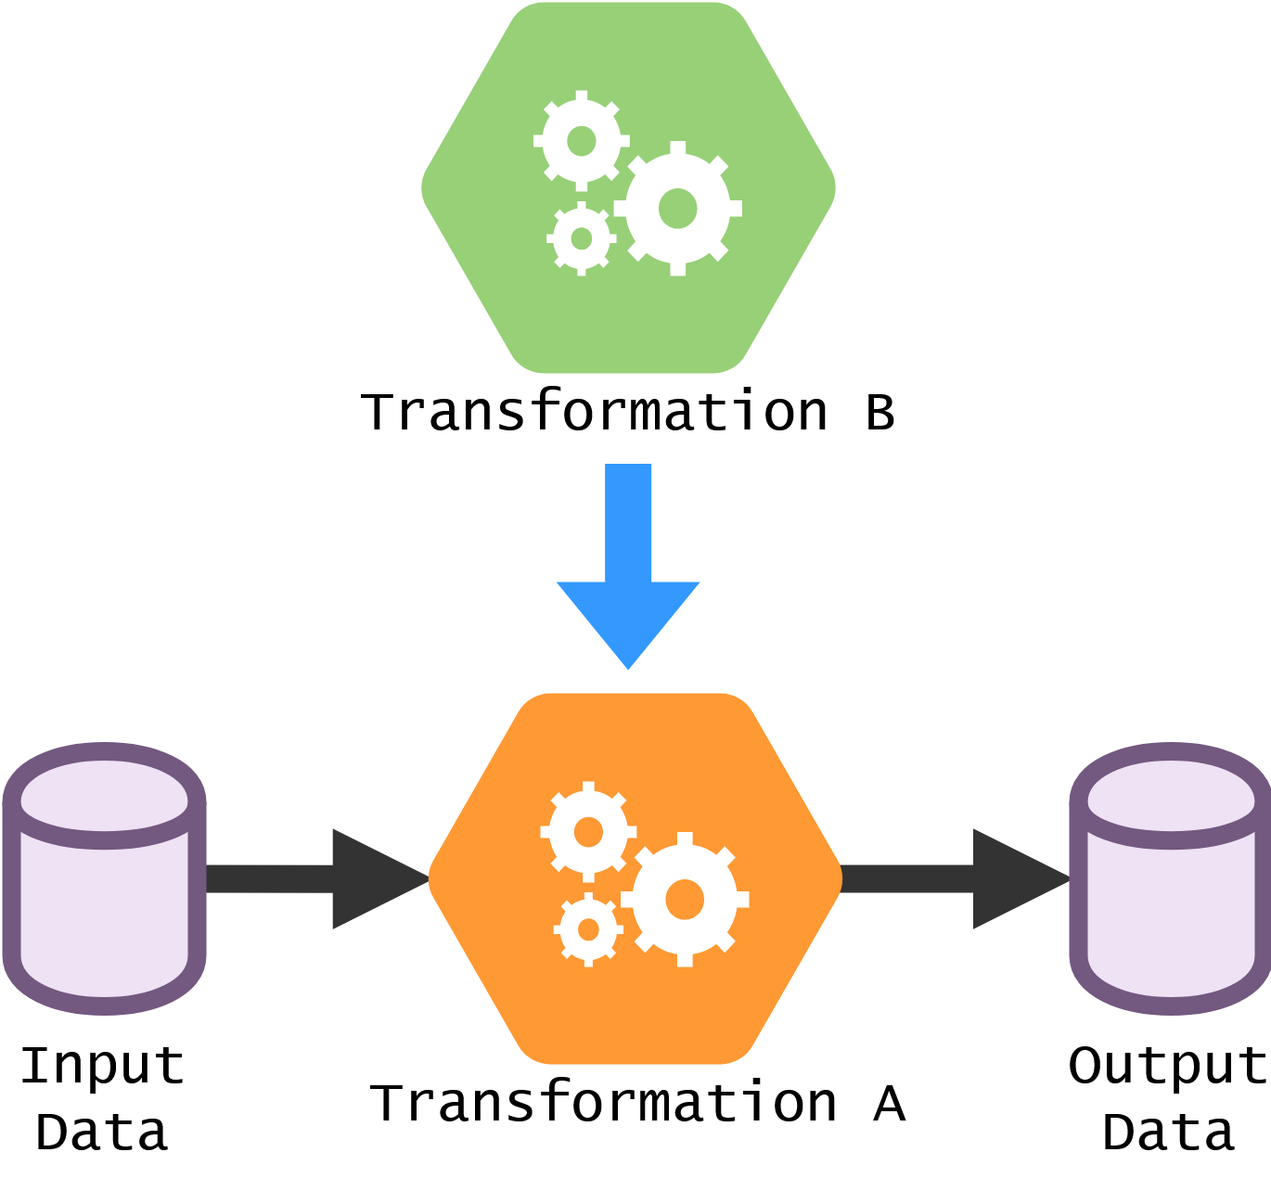
Provenance of pipelines
BACKGROUND
Transformations
Parameters
Environment
Dynamic updates
Notes:
9 minute mark

Slide 11
Distributed computing
BACKGROUND
Cloud computing
Vendor lock-in
Complications
Network failure
Node failure
Notes:
Cloud computing is widely adopted. Ease of use, no hardware of your own required.
It is used in many experiments as the size of data grows at an exceptional rate.
Software artifacts called orchestrators are used to manage distributed computing resources
This distributed setting introduces many new complications
10 minute mark

Slide 12




Existing tools
BACKGROUND
Some Examples
Pachyderm
Apache Airflow
Kubeflow (pipelines)
e-Science Central
Notes:
Many complications, struggles and elements of change.
We are not the first to notice these, so there are others as well that try to accomplish (some) of this
Focus on workflow/pipeline deployment tools
Pachyderm open source, but not enough. Also not enough changes were tracked
Apache Airflow workflow focus, no processing -> spark
Luigi same as airflow, by spotify, less mature. Not as good
Kubeflow early alpha/beta stage. Very heavy weight, focus on ML rather than DS
Flyte very promising, main argument against is that its heavy weight
e-Science Central seems to align with our vision. Has suddenly disappeared somewhere last year
12 minute mark --- SWITCH

Slide 13
Architecture design
Notes:
Since all of the aforementioned tools have some shortcomings,
we decided to try and define what a true, complete solution needs
a conceptual framework that would tackle all problems, can be implemented in multiple ways and so move along with time

Slide 14
Requirements
ARCHITECTURE
Architecturally significant requirements
Track changes to data, code, and pipelines
Deploy and run pipelines
Distributed and localized
Minimize performance impact
Be agnostic towards the experiment
Automation
Notes:
Track changes in data -> Think of a new way
Track changes in code -> VCS
Track changes in pipelines -> Redefine in terms of proven tools
Deploy and run pipelines -> Orchestration
Be agnostic towards the experiment -> Virtualization & black boxing
Handle big data -> Process as streams
15 minute mark

Slide 15
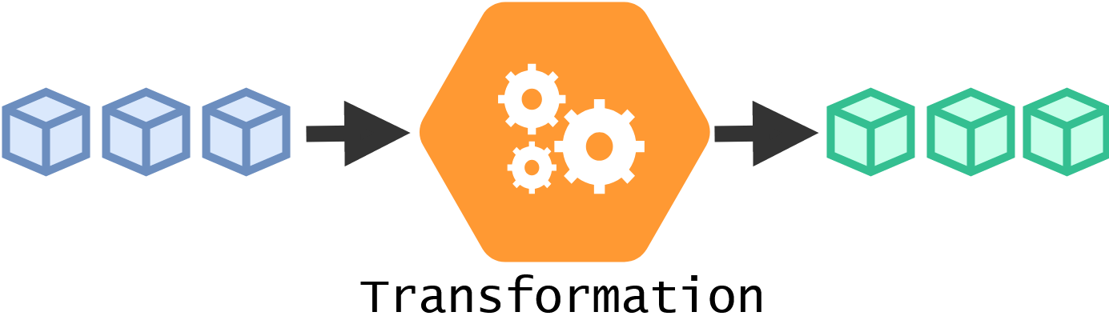
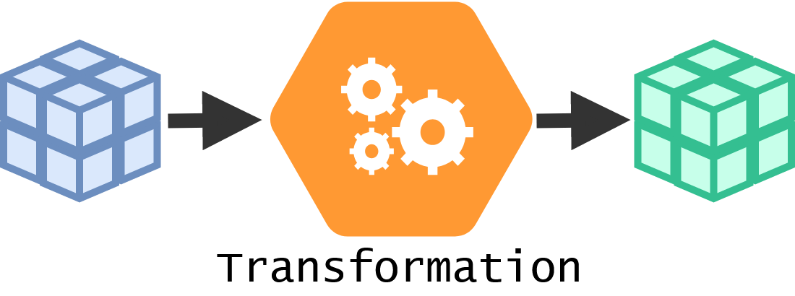
Concepts and abstractions
ARCHITECTURE
Batch vs Stream
Bounded stream processing
Notes:
Which brings us to some abstractions and concepts:
Data processing has two main approaches:
Batch processing processes data in groups, or batches. Large chunks at once converting an input batch into an output batch. Stream processing chunks the entire data set processes them per data element, creating a flow. Allows for parallelization in distributed settings
Bounded stream processing is simply a predefined finite-length stream
You process a batch as a stream
16-17 minute mark

Slide 16
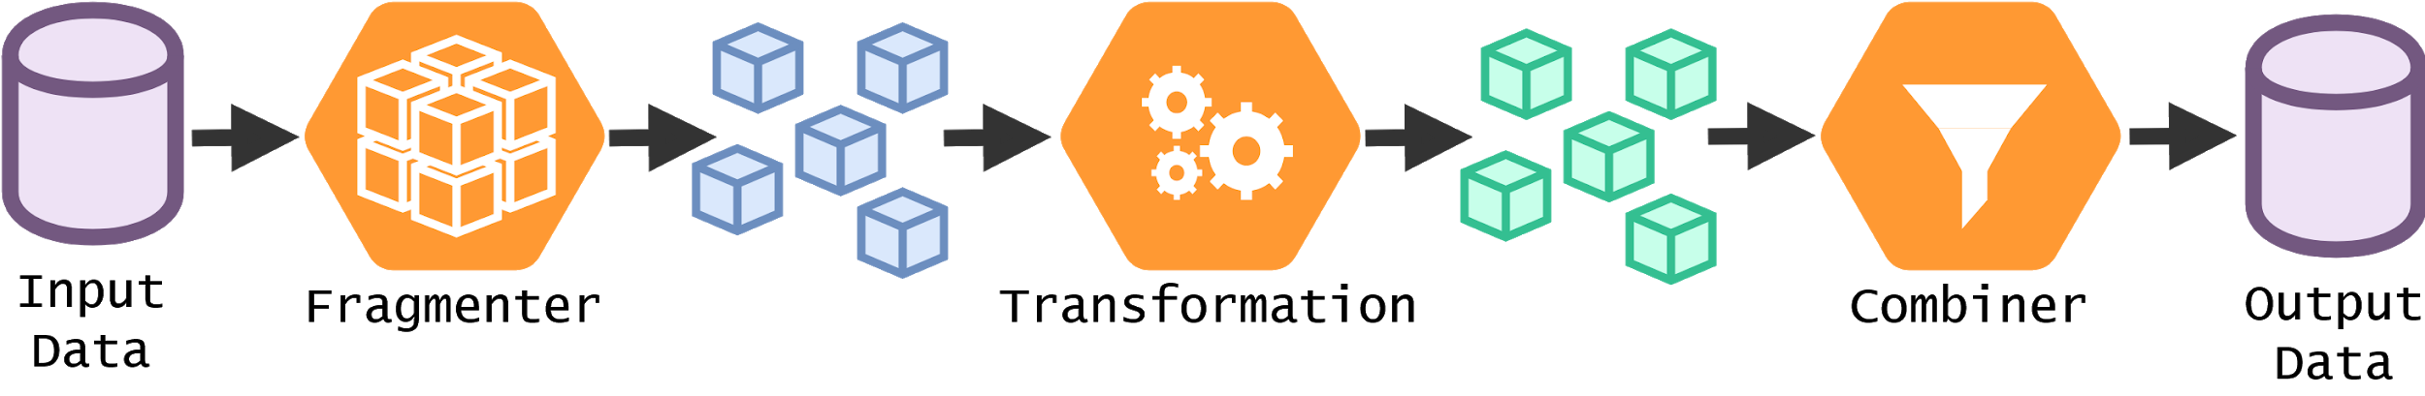
Concepts and abstractions
ARCHITECTURE
Fragments
Encapsulated form of data
Fragmenter & Combiner
Notes:
Since data has all different kinds of shapes and sizes. We want a unified way to handle this, such that we can serve any form of data as a stream.
We introduce the Fragment-abstraction. It is an abstraction over data which decouples it from files. A fragment is simply any (piece of) data that a user defines. This can be an image, a set of images, a few rows from a CSV file, or the entire dataset. Transforming pipelines operating on streams of data into operating on streams of fragments.
To handle this… Fragmenter & combiner are introduced, responsible for ….
Secondly: decouple initial data versioning from pipeline deployment, because they are separate and can occur by different scientists
Some parts only need to exist when a pipeline is executed, others should be long-lived
19 minute mark

Slide 17
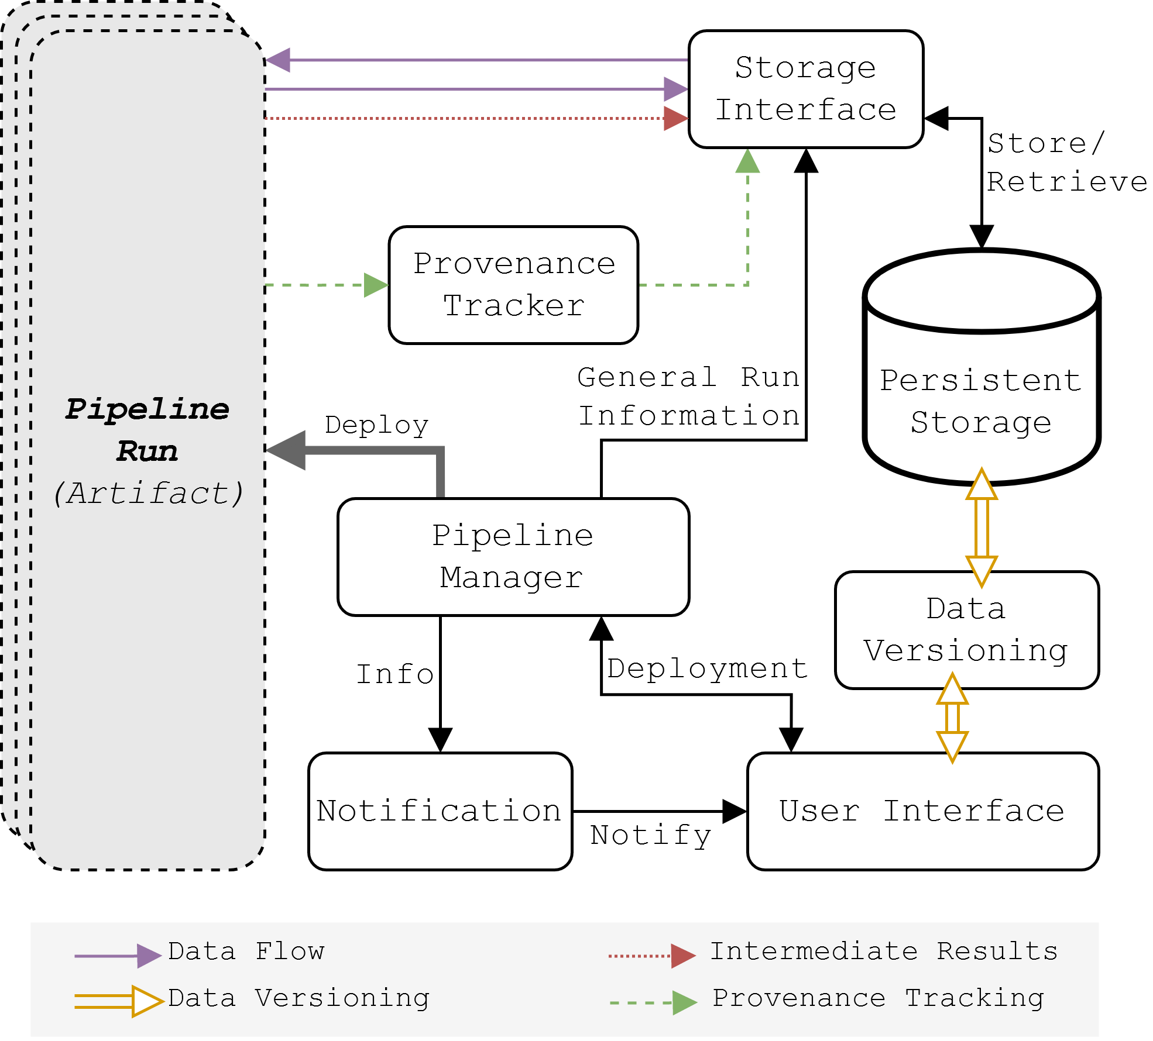
Pipeline infrastructure
ARCHITECTURE
Highlights:
User interface
Pipeline manager
Storage interface
Provenance tracker
Notes:
Which brings us to the architectural overview
2 main parts: artifacts and their infrastructure, which generates and deploys the artifacts
Bla bla bla this is what each of them does
Finally, there is data versioning…
1 minute mark

Slide 18
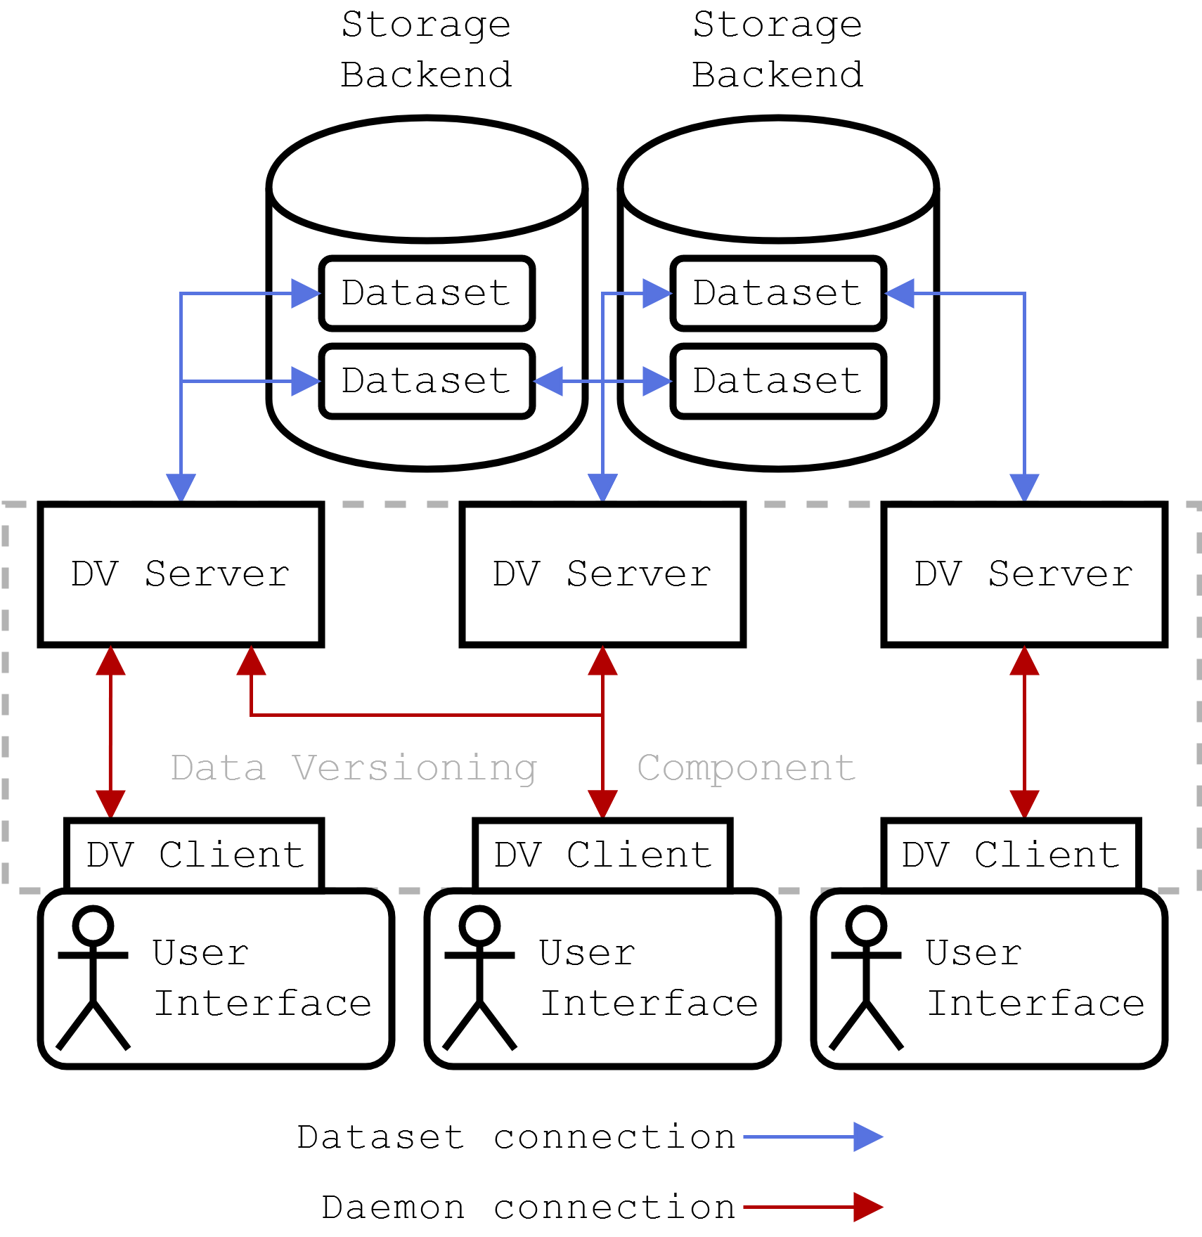
Data versioning
ARCHITECTURE
Existing tools are lacking
Collaboration on data sets
Access control
No wasted resources
Three-layer architecture
Storage backend
DV server
DV client
Notes:
Just explain the headers
1 minute mark

Slide 19
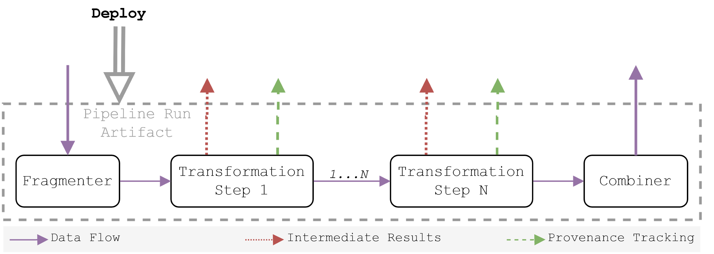
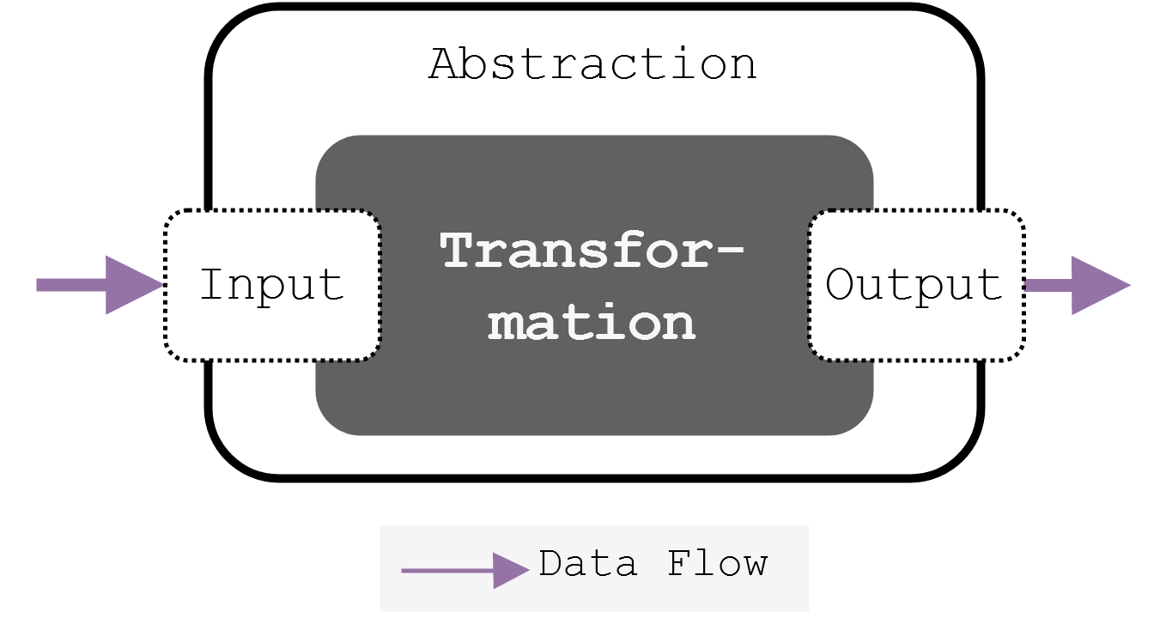
Pipeline artifacts
ARCHITECTURE
Fragmenter & Combiner
Transformation steps
Notes:
It should be accessible and agnostic, similar to the fragment abstraction
A user should be able to do anything (black box), but still have interaction with the framework
We can take care of moving data, tracking lineage etc,
The user only has to interact with minimal interfaces provided by the framework
23 minute mark --- SWITCH

Slide 20

Implementation

Slide 21
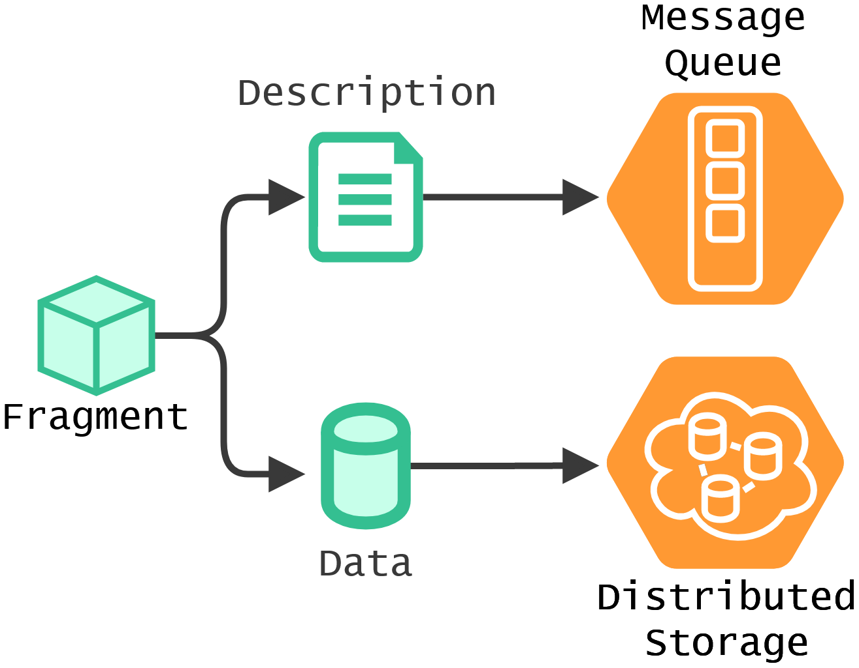
Design choices
Microservices
Docker
Kubernetes
Fragment implementation
Notes:
Docker for both microservices and user-defined transformations
Kubernetes is the resource provisioner for pipeline deployment
Fragment descriptions = metadata that can be passed around via message queues
Fragment data = the actual data described by a fragment description
25 minute mark

Slide 22
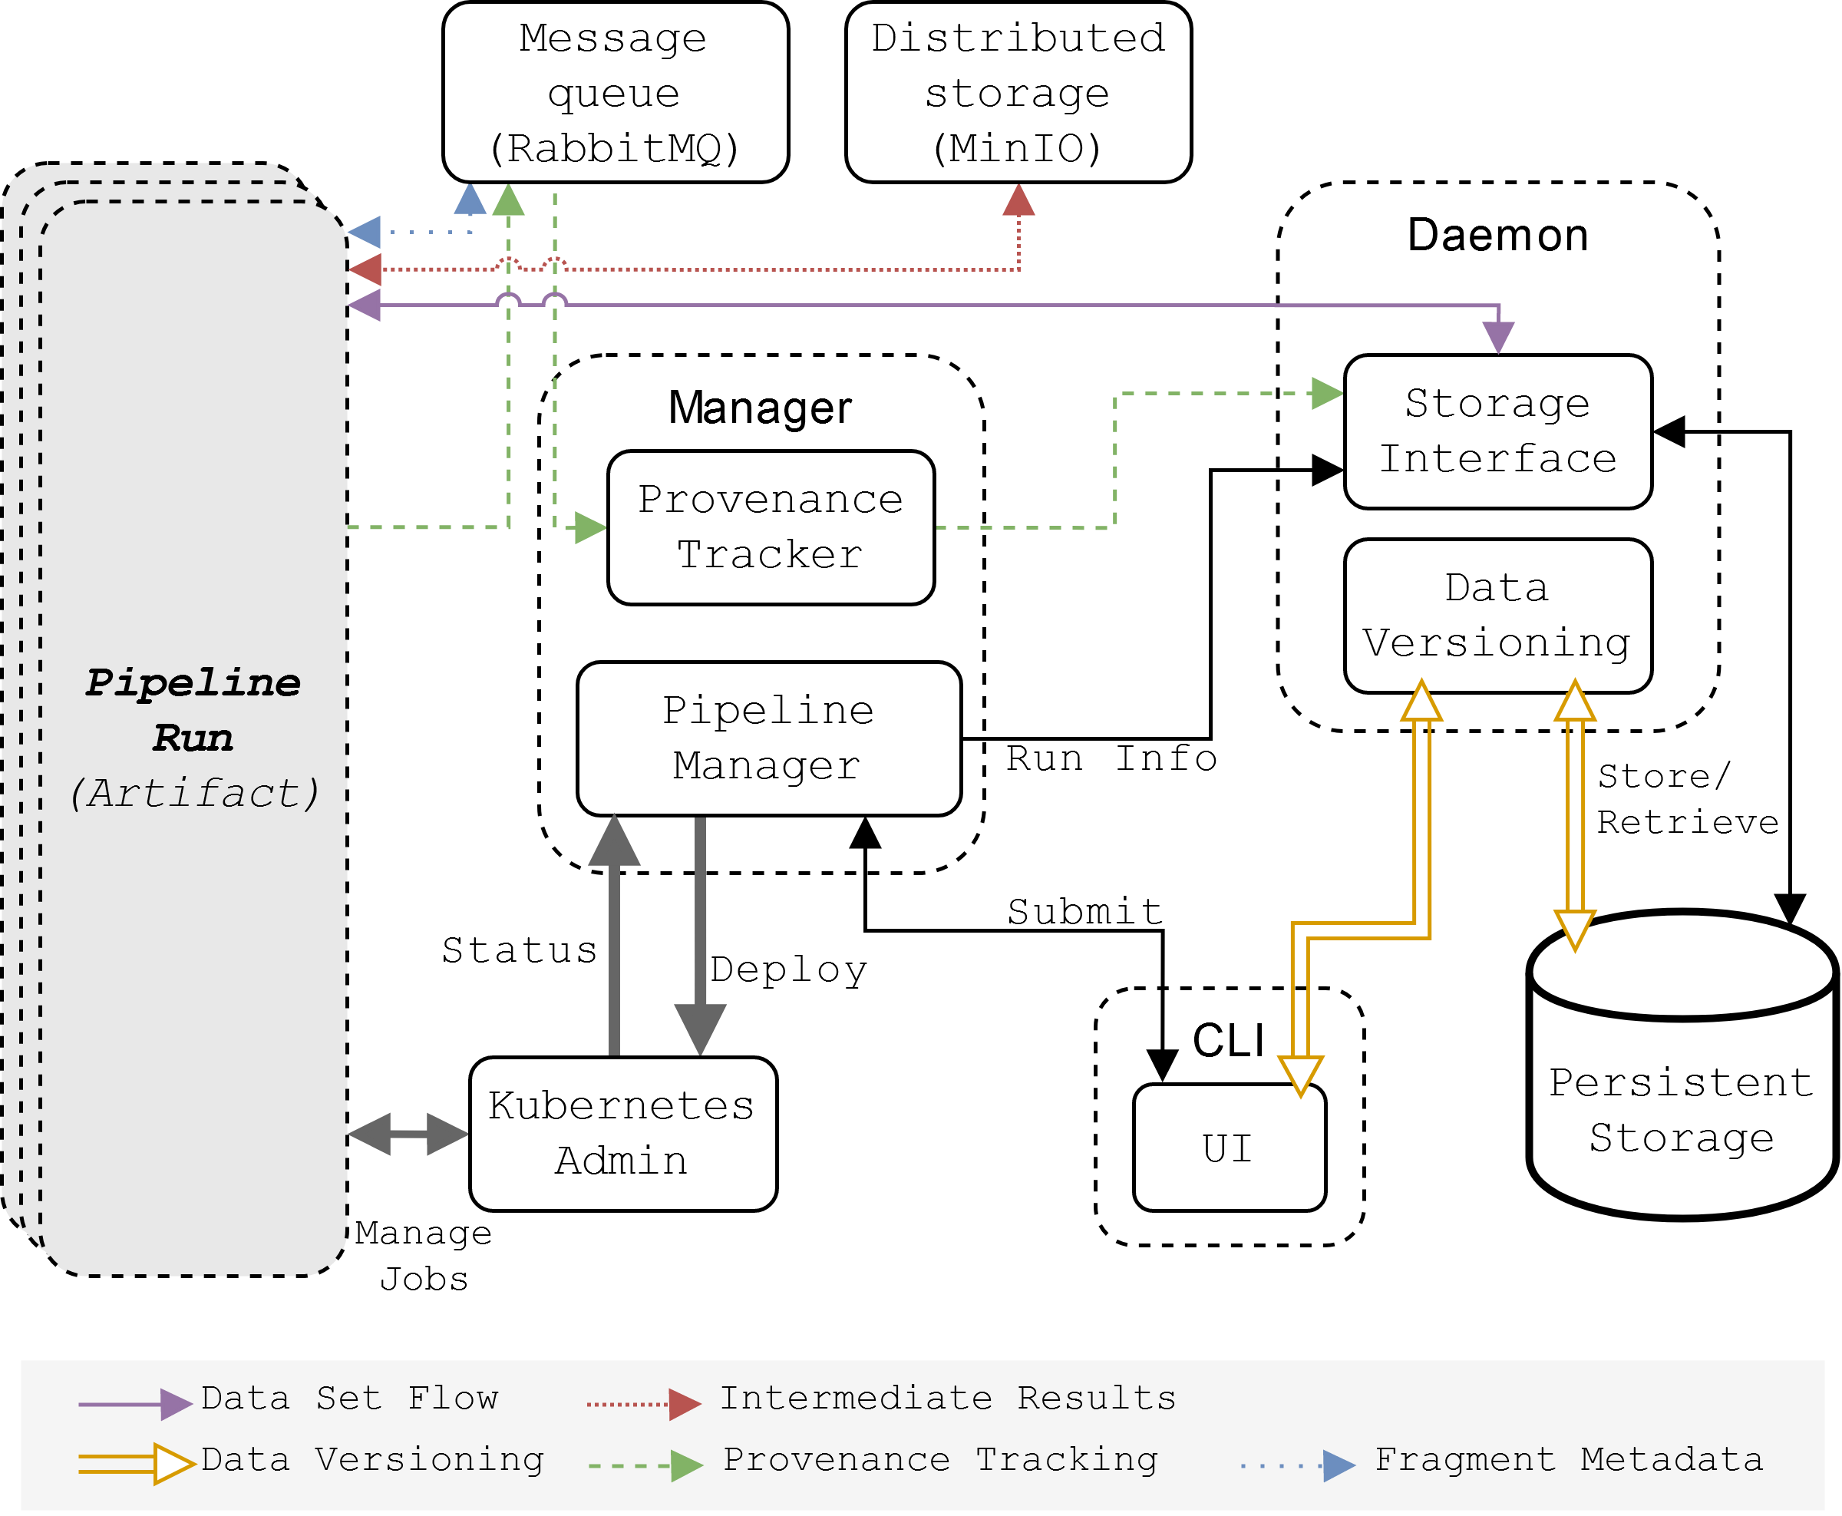
Notes:
Certain element are combined. Due to time, but not breaking any distinctions.
MQ, MinIO and Kubernetes admin can be seen here.
Don’t dwell on this!
27-28 minute mark

Slide 23
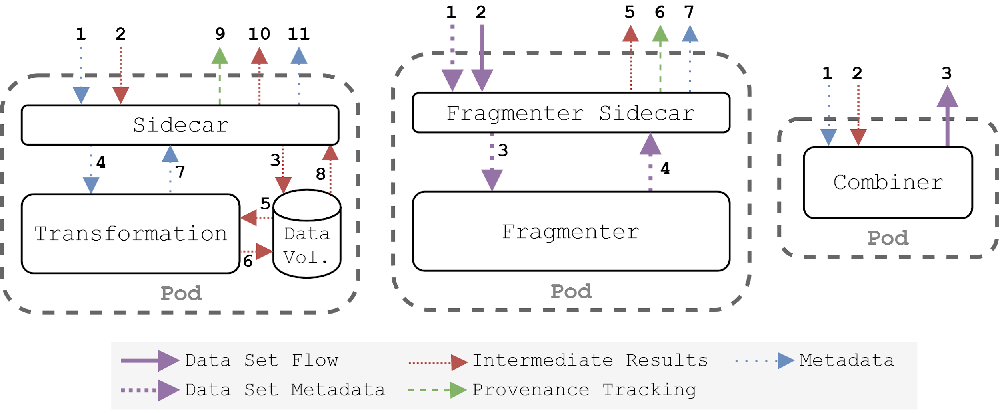
Pipeline artifact components
Notes:
Sidecar is used to abstract away everything and keep language client minimal
Shared volume to store data, such that data is perceived as if it is on disk to the transformation (if questions you can ask them later)
30 minute mark

Slide 24
Evaluation
Notes:
Iterum was evaluated by reimplementing two use cases from the domain, demonstrating different aspects of Iterum.
For both use cases the “performance” results and the time it took to run were compared to the original experiments.

Slide 25
Use case 1: FeatBoost

Slide 26
FeatBoost
USE CASE 1: FEATBOOST
“A framework for feature selection through boosting” [1]
Feature selection algorithm
Subset of Isolet speech data set
Single file about 5 MB in size
Notes:
Relatively simple

Slide 27
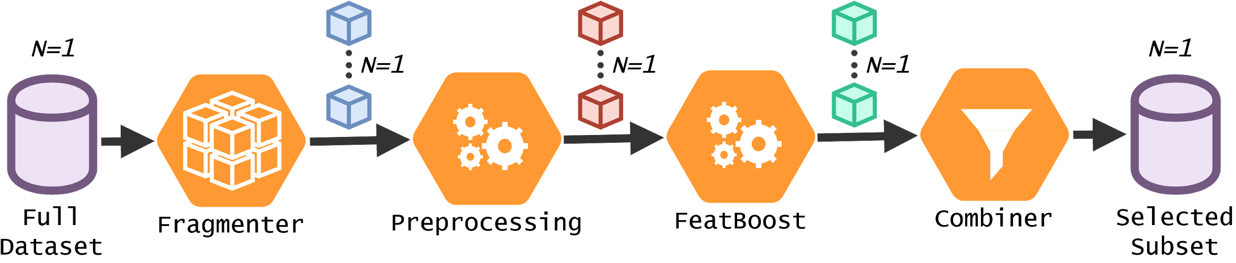
Pipeline definition
USE CASE 1: FEATBOOST
Notes:
Batch processing (1 data set -> 1 fragment -> 1 result)

Slide 28
Results
USE CASE 1: FEATBOOST
Environment | Results
Local | baseline
Docker | identical
Microk8s | identical
Iterum | identical
GCloud | identical
Iterum | identical
Notes:
2-factor evaluation:
Performance of models, so the results of the implemented experiments
Performance, in terms of run time, impact of Iterum

Slide 29
Runtime results
USE CASE 1: FEATBOOST
Run times → | Fragmenter | Preprocess | FeatBoost | Total runtime
Local | N.A. | < 1s | 00:19:18 | 00:19:18
Docker | N.A. | < 1s | 00:19:49 | 00:19:49
Microk8s | N.A. | < 1s | 00:30:23 | 00:30:23
Iterum | < 1s | < 1s | 00:30:19 | 00:30:20
GCloud | N.A. | < 1s | 00:25:48 | 00:25:48
Iterum | < 1s | < 1s | 00:26:00 | 00:26:00

Slide 30
Use case 2: Egocentric photo stream
Notes:
XX minute mark --- SWITCH

Slide 31
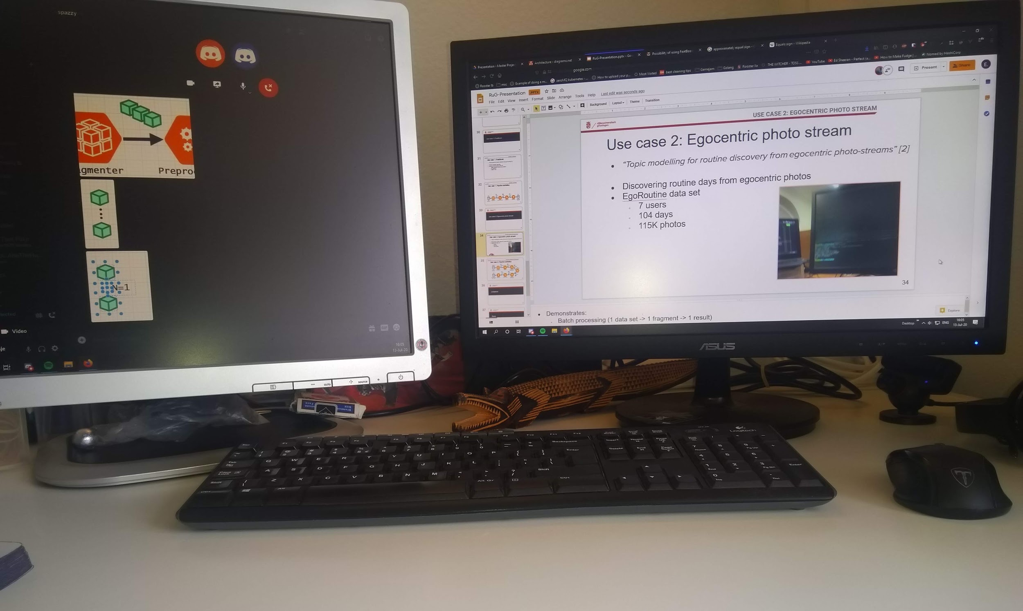
Egocentric photo stream
USE CASE 2: EGOCENTRIC PHOTO STREAM
“Topic modelling for routine discovery from egocentric photo-streams” [2]
Discovering routine days
EgoRoutine data set
7 users
104 days
115K photos
16-07-20_14-02-32.jpg

Slide 32
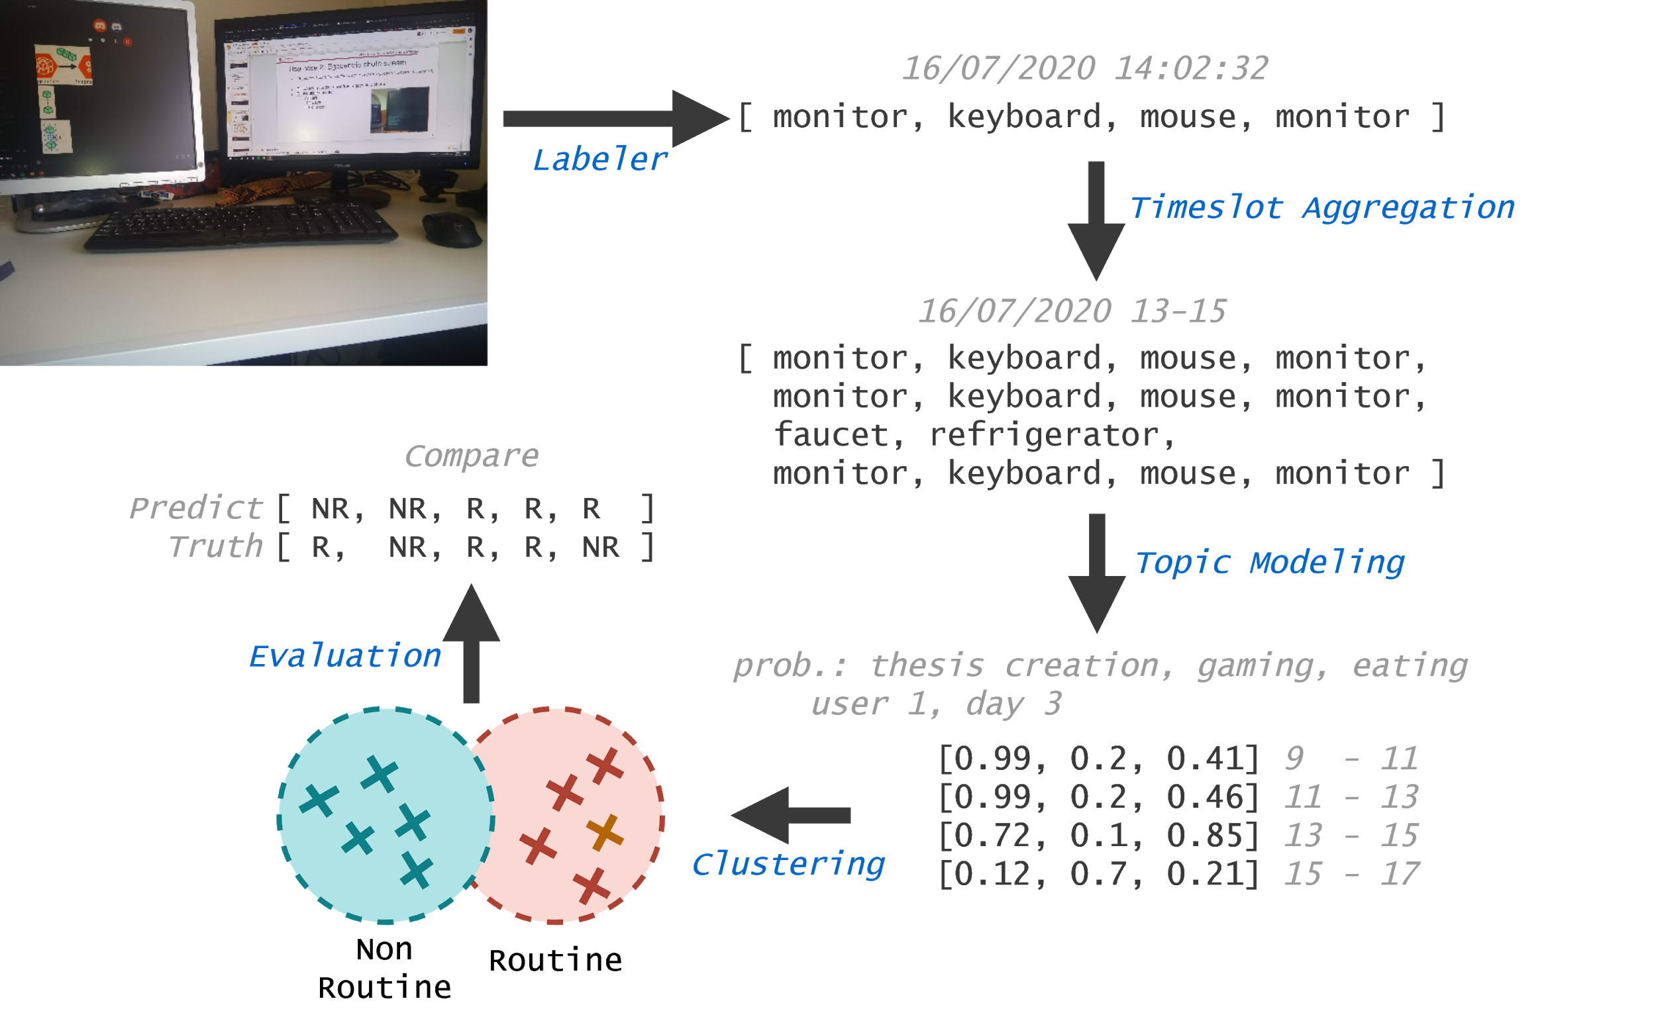
USE CASE 2: EGOCENTRIC PHOTO STREAM

Slide 33
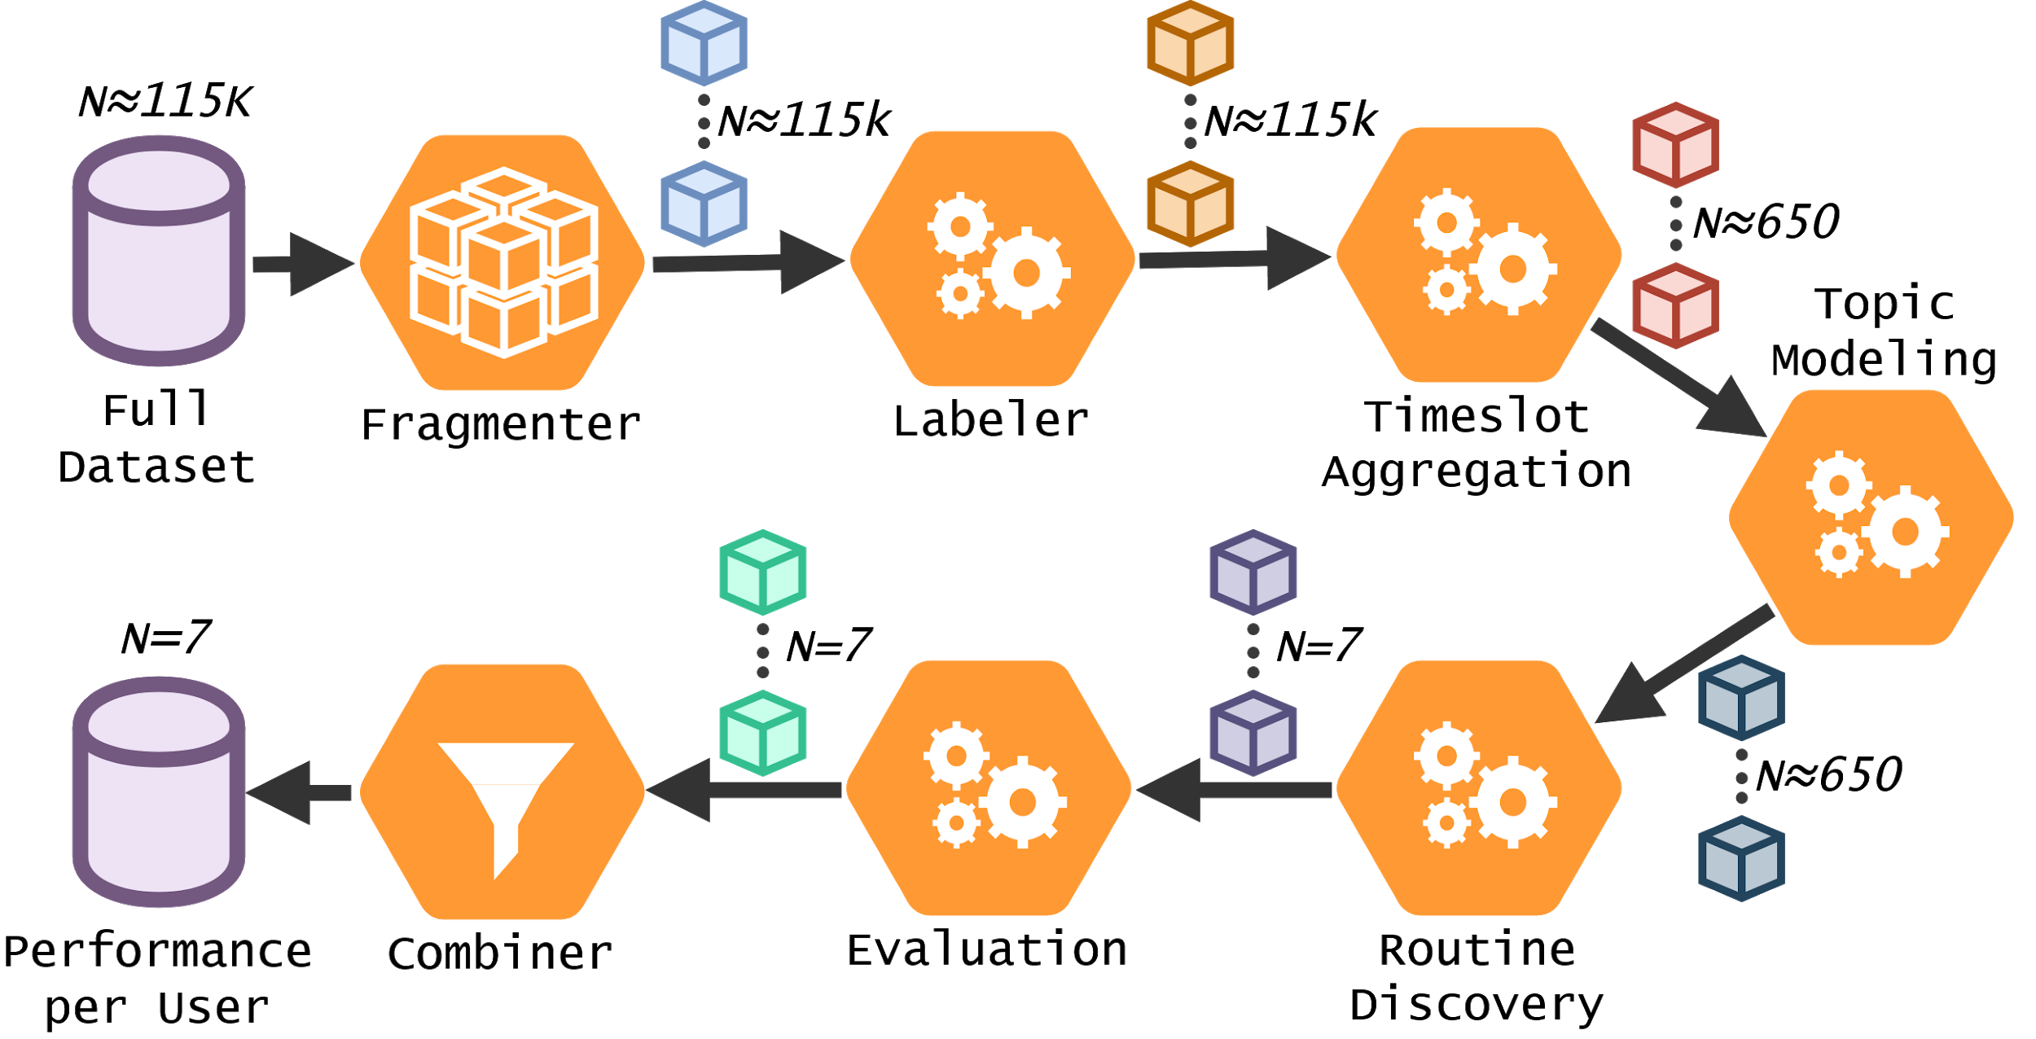
Pipeline definition
USE CASE 2: EGOCENTRIC PHOTO STREAM

Slide 34
Results
USE CASE 2: EGOCENTRIC PHOTO STREAM
Comparison to the original experiment
 | Ensemble (original) | Yolov3 (original) | Iterum (GCloud)
Accuracy | 0.80 | 0.71 | 0.71
F-1 | 0.77 | 0.68 | 0.68
Precision | 0.79 | 0.72 | 0.71
Recall | 0.82 | 0.74 | 0.73
Notes:
Original had an ensemble of classifiers, we did not
Results are still presented, we compare to those
Result not identical due to random order they are presented in and possible different seeds

Slide 35
Runtime results
USE CASE 2: EGOCENTRIC PHOTO STREAM
Comparison between different environments
Similar performance results for each environment
Impact disappears
 | Frag. | Labeler | Time aggr. | Topic. | Rout.
Local | N.A. | 6:06:47 | < 20s | < 20s | < 20s
Docker | N.A. | 5:55:28 | < 20s | < 20s | < 20s
k3d | N.A. | 5:41:10 | < 20s | < 20s | < 20s
Iterum | 0:22:05 | 6:48:43 | 0:19:10 | < 20s | < 20s
GCloud | N.A. | 11:04:12 | < 20s | < 20s | < 20s
Iterum | 0:43:46 | 10:18:09 | 0:50:31 | < 20s | < 20s
Notes:
Performance IS due to IO overhead
This is why it disappears after Time Aggr. since it aggregates 115k -> 650
2:30 minutes

Slide 36
Runtime results
USE CASE 2: EGOCENTRIC PHOTO STREAM
Single node versus parallelized setup
Parallelization capabilities
Speed up of factor ~4
 | Frag. | Labeler | Time aggr. | Topics | Rout.
1 node | 0:43:46 | 10:18:09 | 0:50:31 | < 20s | < 20s
3 nodes | 0:58:08 | 2:38:56 | 0:50:04 | < 20s | < 20s
Notes:
We analyzed Iterum’s ability to paralellize
1 minute tops, we performed 2: 1 node vs 3 node. Speed up is easy, (as we’ll show you in the demo)

Slide 37
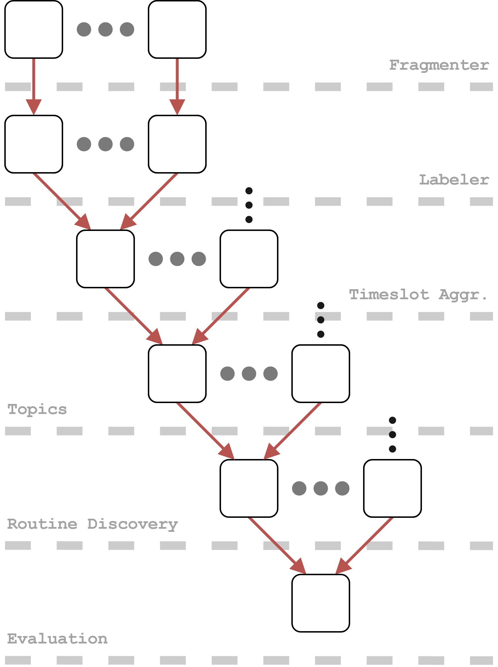
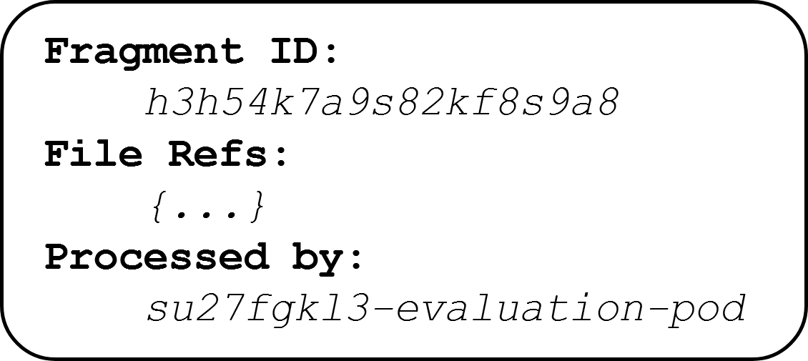
Lineage data
EVALUATION
Fragment
Predecessor
Notes:
1 minute tops

Slide 38
Limitations
EVALUATION
Performance impact due to IO overhead
Ordered streams
Dynamic updates
User responsibility
Data versioning platform
IMPLEMENTATION!
Notes:
1 minute for this and the next slide, maybe 1:30, then demo

Slide 39
Limitations
EVALUATION
IO overhead → Direct messaging
Ordered streams → Ordered messaging
Dynamic updates → Future feature (ff)
User responsibility → Can be automated (ff)
Data versioning platform → (ff), or use more mature platform
Notes:
Glance over it, do not dwell
40-42 minute mark --- SWITCH -- DEMO

Slide 40
Demo
Notes:
15 minute demo

Slide 41
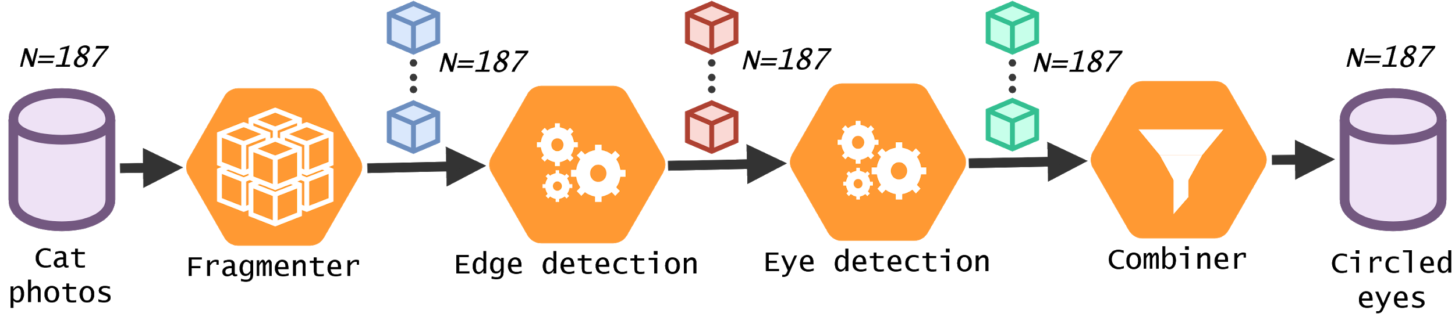
Demo pipeline configuration
EVALUATION
Notes:
40-42 minute mark --- DEMO

Slide 42
Conclusions
properly represents the architecture
tracks provenance of code, data and pipelines
makes experiments reproducible
can have a performance impact due to its implementation
is in its early alpha stage
requires users to use provided abstractions
Notes:
Goal: 4 minutes left

Slide 43
Future work
Explore use cases outside of academic research
Re-implement the architecture
Use a more mature deployment tool
Go beyond the proof-of-concept implementation
Dynamic updates and long-lived pipelines
Investigate failure modes

Slide 44
References
REFERENCES
[1] A. Alsahaf et al. “A framework for feature selection through boosting”
[2] Estefania Talavera et al. “Topic modelling for routine discovery from egocentric photo-streams”

Slide 45


Slide 46



Slide 47
Elements of change
BACKGROUND
Prior to a pipeline run
Input data (data sets)
Source code of transformations
Parameters
Configuration of pipelines
Metaparameters
Environment
During a pipeline run
Lineage of data
Intermediate results
Dynamic updates
Notes:
Input data: example raw data -> cleaned data, adding more photo’s to a set
New data = new behaviour
Overarching configuration. If they change the DAG structure, or parameters
Environment: same code on my machine may produce (ever so slightly) different results from the same program on your machine

Slide 48
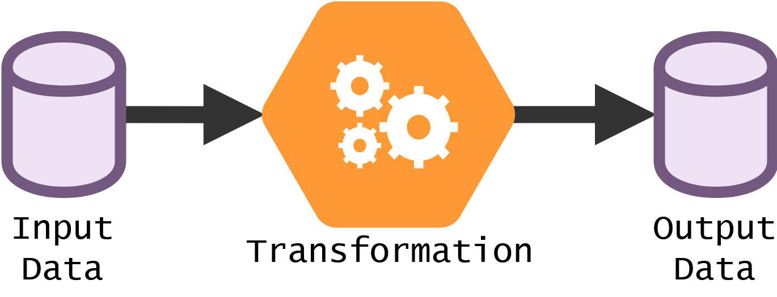
Data science experiments
PROBLEM STATEMENT
A black box
Notes:
Now for what a general data science experiment looks like Transformation is a black box, a user can do anything basically
There is input, which is transformed and produces some kind of output

Slide 49
Scoping
PROBLEM STATEMENT
Research-wide
Data science
Pipelines
Predefined data sets
Personal
Notes:
The entirety of academic research is too much
We focus on the domain of data science as it has interesting problems: big data, many fields, distributed computing Specifically on pipelines over predefined datasets
Personal…
Pipelines: Preprocessing, algorithm, evaluation

Slide 50
Infrastructural components
Distributed storage (MinIO)
Message queue (RabbitMQ)
Kubernetes Admin
Notes:
MinIO -> distributed storage for intermediate results
RabbitMQ -> messaging metadata (descriptions)
Kubernetes admin to deploy jobs and pipelines + scheduling etc
25-26 minute mark

Slide 51
Data flow
<Om te demonstreren hoe de data flow werkt. Zo van: iemand submit een pipeline, manager geeft door aan kubernetes API, pipeline artifact jobs worden gestart, data wordt gedownload via daemon, fragmenter fragment alles, etc>
Notes:
31 minute mark

Slide 52
Requirements
ARCHITECTURE
Key drivers (Quality attributes)
Core
Track provenance
Deploy and run pipelines
Accessibility
Be agnostic towards the experiment
Handle big data
Automation
Portability
Distributed and localized
Performance
Notes:
We identified a few key quality attributes that would be important for such a framework to be adopted
Acc: many researchers from different fields need to use it, not all CS
Per: Slow stuff will not be adopted, so it needs to be performant
Por: Technology changes rapidly, users use different platforms. We need to run consistently on all of them
Agnostic: Never limit users in what they can do
Arbitrary file size, since we don’t want to limit the users
Both single node and distributed setup. We believe smaller experiments are still run today + dev setup. Also all the others are very heavy weight
Tracking lineage in order to be able to explain the results
Automation. Not all people are CS’ers, many factors are quite intricate, but also consistent. So they could be automated. Think of moving data over network, connecting computation nodes and tracking certain provenance.
15 minute mark

Slide 53
Results
USE CASE 1: FEATBOOST
Run times → | Total | Preprocess | FeatBoost | Fragmenter | Results
Local | 00:19:18 | < 1s | 00:19:18 | N.A. | baseline
Docker | 00:19:49 | < 1s | 00:19:49 | N.A. | identical
Microk8s | 00:30:23 | < 1s | 00:30:23 | N.A. | identical
Iterum | 00:30:20 | < 1s | 00:30:19 | < 1s | identical
GCloud | 00:25:48 | < 1s | 00:25:48 | N.A. | identical
Iterum | 00:26:00 | < 1s | 00:26:00 | < 1s | identical

Slide 54
Iterum specific extensions
Explore ways to make provenance information insightful
Investigate failure modes
Dynamic updates and long-lived pipelines
Go beyond the proof-of-concept implementation

